Slide 1
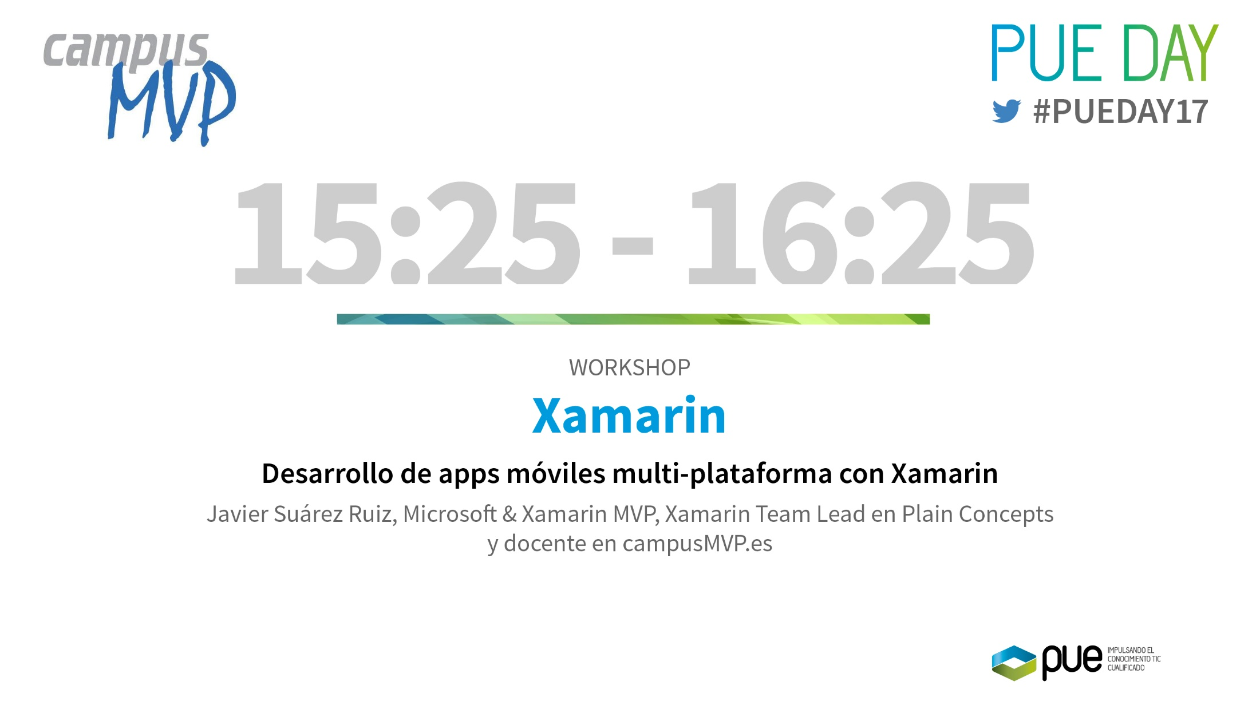
WORKSHOP XAMARIN
“Desarrollo de apps móviles multi-plataforma con Xamarin”.
Javier Suárez Ruiz, Microsoft & Xamarin MVP. Docente en campusMVP.es

Slide 2
Javier Suárez Ruiz
Developer Plain Concepts
Microsoft MVP Windows Platform Development & Visual Studio Tools
Xamarin MVP
Docente CampusMVP
Blog: http://geeks.ms/blogs/jsuarez
Email: javiersuarezruiz@hotmail.com / jsuarez@plainconcepts.com
Twitter: @jsuarezruiz

Slide 3

Formamos programadores para el mundo real
con tutores expertos que usan cada día las tecnologías que enseñan
Más de 10 años enseñando online buenas prácticas de desarrollo
Más de 10.000 alumnos formados y encantados
Más de 800 empresas satisfechas
Consigue descuentos y eBooks gratuitos entrando ahora en:
promos.campusMVP.com/pue

Slide 4





Xamarin – Solución móvil completa
Desarrollo
Test
Build
Distribuir
Monitorear
Notes:
Xamarin is your complete mobile solution.
Xamarin Platform is usually what you hear about which is building native iOS, Android, Mac, and Windows Apps all in C#
However Xamarin offers a wide range of products for developers to go mobile including Test Cloud, Hockey App, and a way to learn all of mobile with University.

Slide 5
Desarrollo
Notes:
Xamarin is your complete mobile solution.
Xamarin Platform is usually what you hear about which is building native iOS, Android, Mac, and Windows Apps all in C#
However Xamarin offers a wide range of products for developers to go mobile including Test Cloud, Hockey App, and a way to learn all of mobile with University.

Slide 6
¿Qué es nativo?
Notes:
What makes up a “Native” mobile application? I am sure you have heard the “native” thrown around, but what does that really mean?

Slide 7
Notes:
A native app needs a lot of things, but three important ones stick out:
Native User Interface: Apps need to look and act correct per platform.
Full SDK Access: As a developer we need to add the latest and greatest features
Native Performance: Needs to be fast and fluid

Slide 8
Arquitectura de Apps móviles
Notes:
So we know what we want how do we get there? Let’s talk about the state of mobile development.

Slide 9
Enfoque nativo
iOS
Android
Windows
Objective-C
Xcode
Java
Android Studio
C#
Visual Studio
No se comparte código • Diferentes lenguajes & herramientas de desarrollo • Múltiples equipos
Notes:
Multiple Teams
Multiple Code Bases
Expensive & Slow
Positive = Great apps delivered to user’s platform
Negative = Development hampered by multiple code bases & fragmentation

Slide 10
Escribir una vez, correr en todo
Lua
Javascript
Actionscript
HTML+CSS
App Generator
Acceso limitado a APIs nativas • Menor rendimiento • Interfaz de usuario más pobre
Notes:
Unhappy Users
Unhappy Developers
Increase in Abandoned Apps
Limited to what is implemented

Slide 11
El enfoque de Xamarin
iOS C# UI
Android C# UI
Windows C# UI
Código compartido C#
Gran cantidad de código compartido C# • 100% acceso nativo a APIs • Alto rendimiento
Notes:
UI build natively per platform, leveraging C#
C# + XAML
C# + XML
C# + XIB
One shared app logic code base, iOS, Android, Mac, Windows Phone, Windows Store, Windows

Slide 12
Xamarin + Xamarin.Forms
iOS C# UI
Android C# UI
Windows C# UI
UI compartida
Código compartido C#
Código compartido C#
Enfoque tradicional
Con Xamarin.Forms: Mayor cantidad de código compartido, app nativa
Notes:
Xamarin recently introduced Xamarin.Forms a new library for cross platform user interface. We will touch up on this later, but this enables you to be highly productive, share code, but build out UI on each platform and access platform APIs.
With Xamarin.Forms you now have a nice Shared UI Code layer, but still access to platform APIs
You can start from native, pick a few screens, or start with forms, and replace with native later

Slide 13
¿Por qué Xamarin?
Notes:
Let’s talk a bit about C# and why it is awesome.

Slide 14
Notes:
Xamarin IS
Native User Interface: Apps need to look and act correct per platform.
Full SDK Access: As a developer we need to add the latest and greatest features
Native Performance: Needs to be fast and fluid

Slide 15
Xamarin gratis e incluido en Visual Studio (Windows & Mac)
Notes:
Including the Free Community Edition

Slide 16
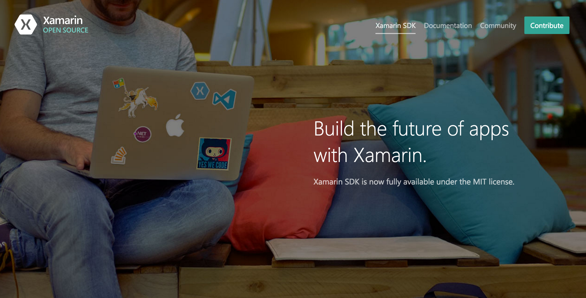
Open Source – open.xamarin.com

Slide 17
¿Por qué C#?
Notes:
Let’s talk a bit about C# and why it is awesome.

Slide 18
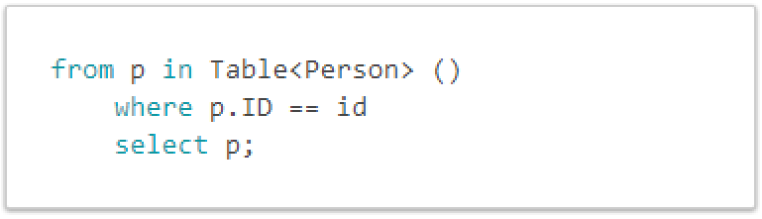
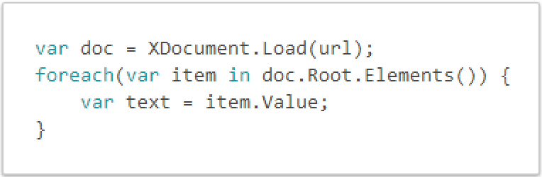
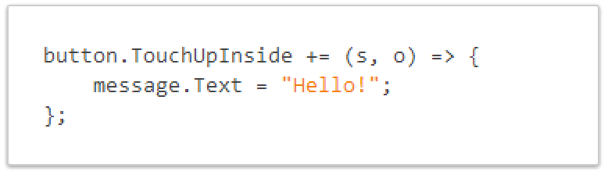
C# mola!
LINQ
XML
Gestión de eventos y delegados

Slide 19
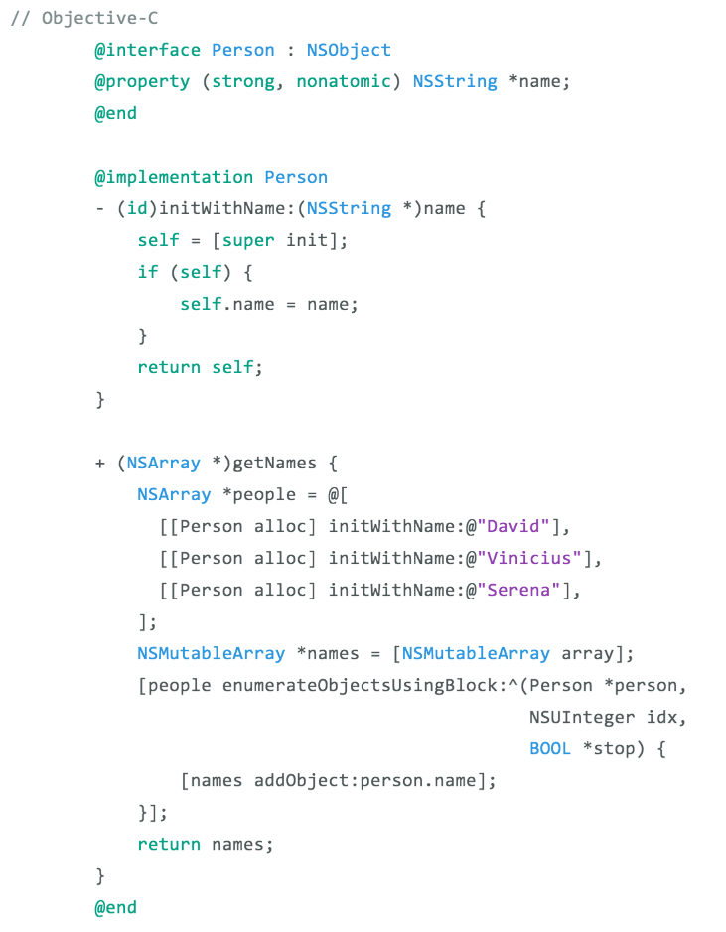
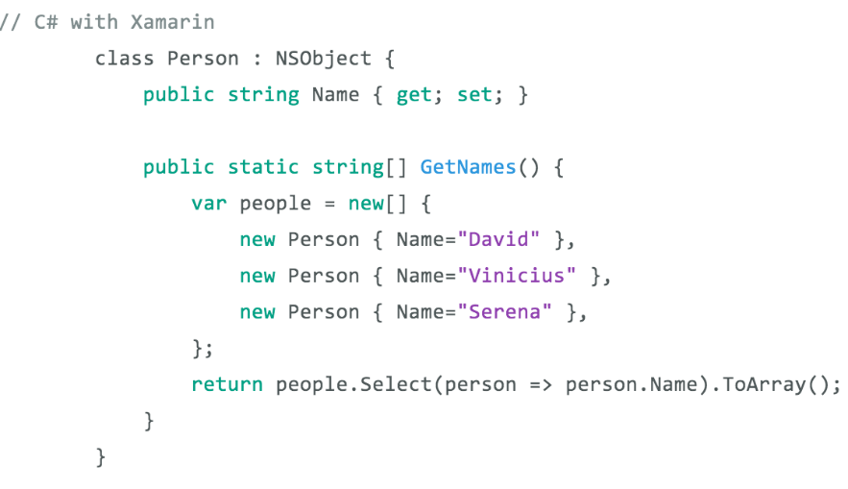
Una comparativa…
Notes:
Here is an example of creating a class with a method to get names
1 Line with LINQ to execute this command
Take advantage of C# features and set properties easily

Slide 20
¿Cómo funciona Xamarin?

Slide 21
Windows APIs
Microsoft.Phone
Microsoft.Networking
Windows.Storage
Windows.Foundation
Microsoft.Devices
System.Net
System
System.IO
System.Linq
System.Xml
System.Data
System.Windows
System.Numerics
System.Core
System.ServiceModel
Notes:
If you have ever developed for a Windows Platform before these .NET namespaces might look familiar.
However, if we go to a new platform such as Windows Phone or Store we have a new SDK to use and a new set of namespaces.

Slide 22
iOS – 100% cobertura
MapKit
UIKit
iBeacon
CoreGraphics
CoreMotion
System.Net
System
System.IO
System.Linq
System.Xml
System.Data
System.Windows
System.Numerics
System.Core
System.ServiceModel
Notes:
You can think of iOS and Android development the same with Xamarin. You can see we have all of our .NET namespaces and libraries, but Xamarin give us 100% api coverage of each iOS API in it’s SDK that we access view C#.

Slide 23
Android – 100% cobertura
Text-to-speech
ActionBar
Printing Framework
Renderscript
NFC
System.Net
System
System.IO
System.Linq
System.Xml
System.Data
System.Windows
System.Numerics
System.Core
System.ServiceModel
Notes:
The same is true for Android as well.

Slide 24
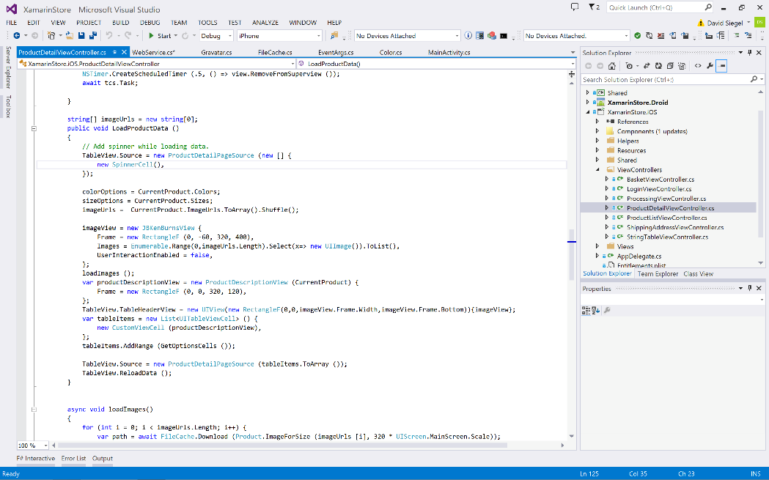
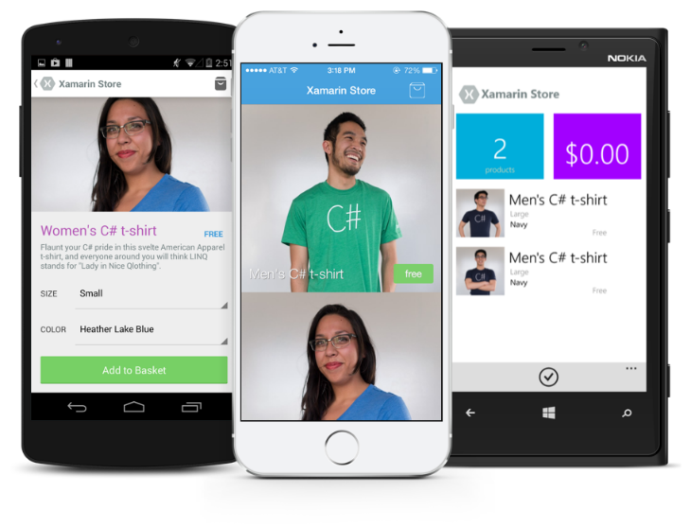
Cualquier cosa que puedas hacer con Objective-C, Swift, o Java se puede hacer con C# y Visual Studio con Xamarin.

Slide 25
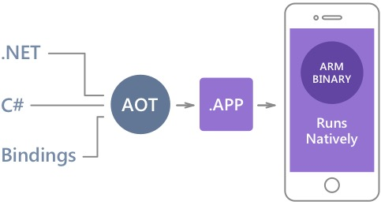
Rendimiento nativo
Xamarin.iOS hace uso de la compilación de Ahead Of Time (AOT) para crear un binario ARM para la Apple’s App Store.
Xamarin.Android toma ventaja de la compilación Just In Time (JIT).
Notes:
There is no compromise on performance.
Xamarin apps look and feel native because they are native.

Slide 26
✓Siempre al día
Soporte al día:
iOS 5
iOS 6
iOS 7
iOS 7.1
iOS 8
iOS 9
iOS 10
Soporte complete a:
Apple Watch
Apple TV
Google Glass
Android Wear
Amazon Fire TV
Tizen
Y más!
Notes:
Apple has a developer preview where Xamarin has alphas ready. Google does not offer this.
Android versions are usually 4 to 8 weeks out for a stable release, but alphas and betas are usually earlier.
Xamarin realizes how important having iOS ready because within 24 hours a large portion of iOS users upgrade
Android on the other hand is much different. After 4 months on the market Android 4.4 only had 1% adoption

Slide 27
Compartir código

Slide 28
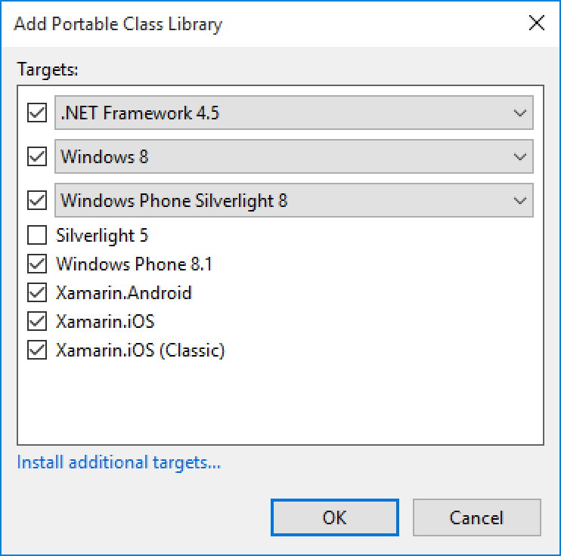
Portable Class Libraries (PCL)
1 Librería
Múltiples plataformas
Incluyendo:
Xamarin.iOS y Xamarin.Android

Slide 29
Estadísticas de código compartido
iCircuit
Touch Draw
Android
iOS
Mac
Windows Phone
Notes:
iCircuit is made by Frank Krueger, a long time Mono & Xamarin developer.
Sharing code lead to 70 to 90% code reuse across platforms speeding up development
Real-time circuit simulator and editor used to design analog and digital circuits
http://praeclarum.org/post/42378027611/icircuit-code-reuse-part-cinq

Slide 30
La experiencia de desarrollo

Slide 31
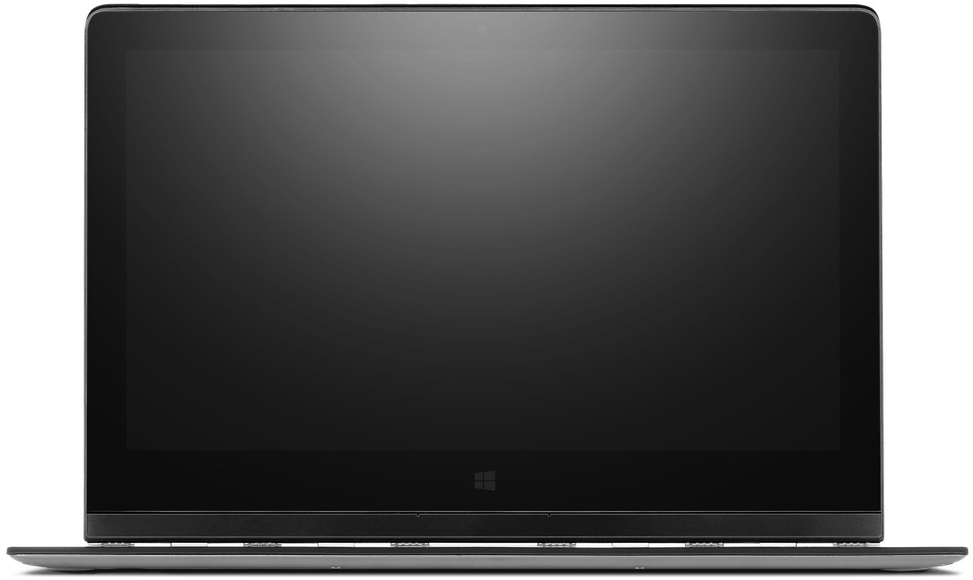
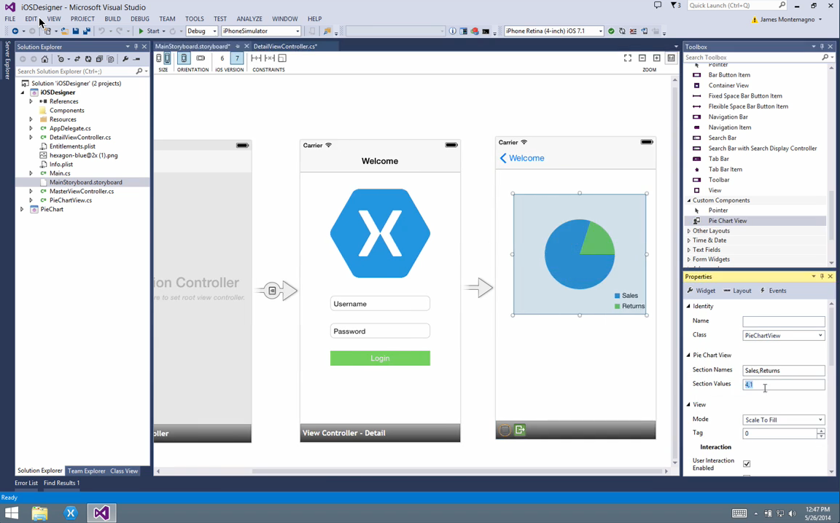
Integración con Visual Studio
Notes:
Single Solution for iOS, Android, and Windows
Leverage Entire Microsoft Ecosystem:
ReSharper
Team Foundation Server
Azure
ASP.NET
Favorite Code Coverage and Profiling Tools
Starter Compatible
Visual Studio 2012, 2013, and 2015 including Community Edition

Slide 32
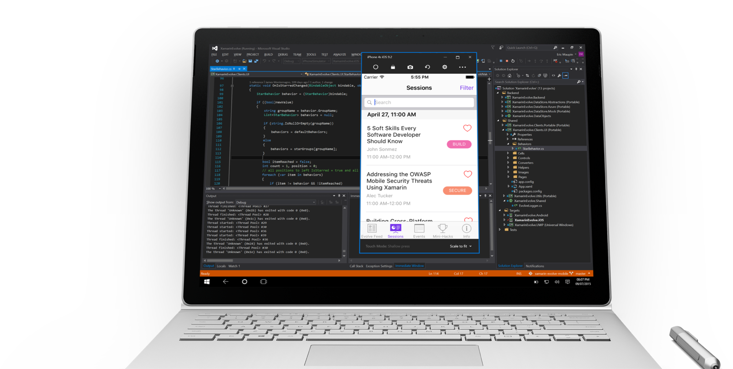
Visual Studio iOS Simulator Remoting
Multi-Touch
Rápido
Rotar, screenshots, cambios de localización
No hace falta dejar VS

Slide 33
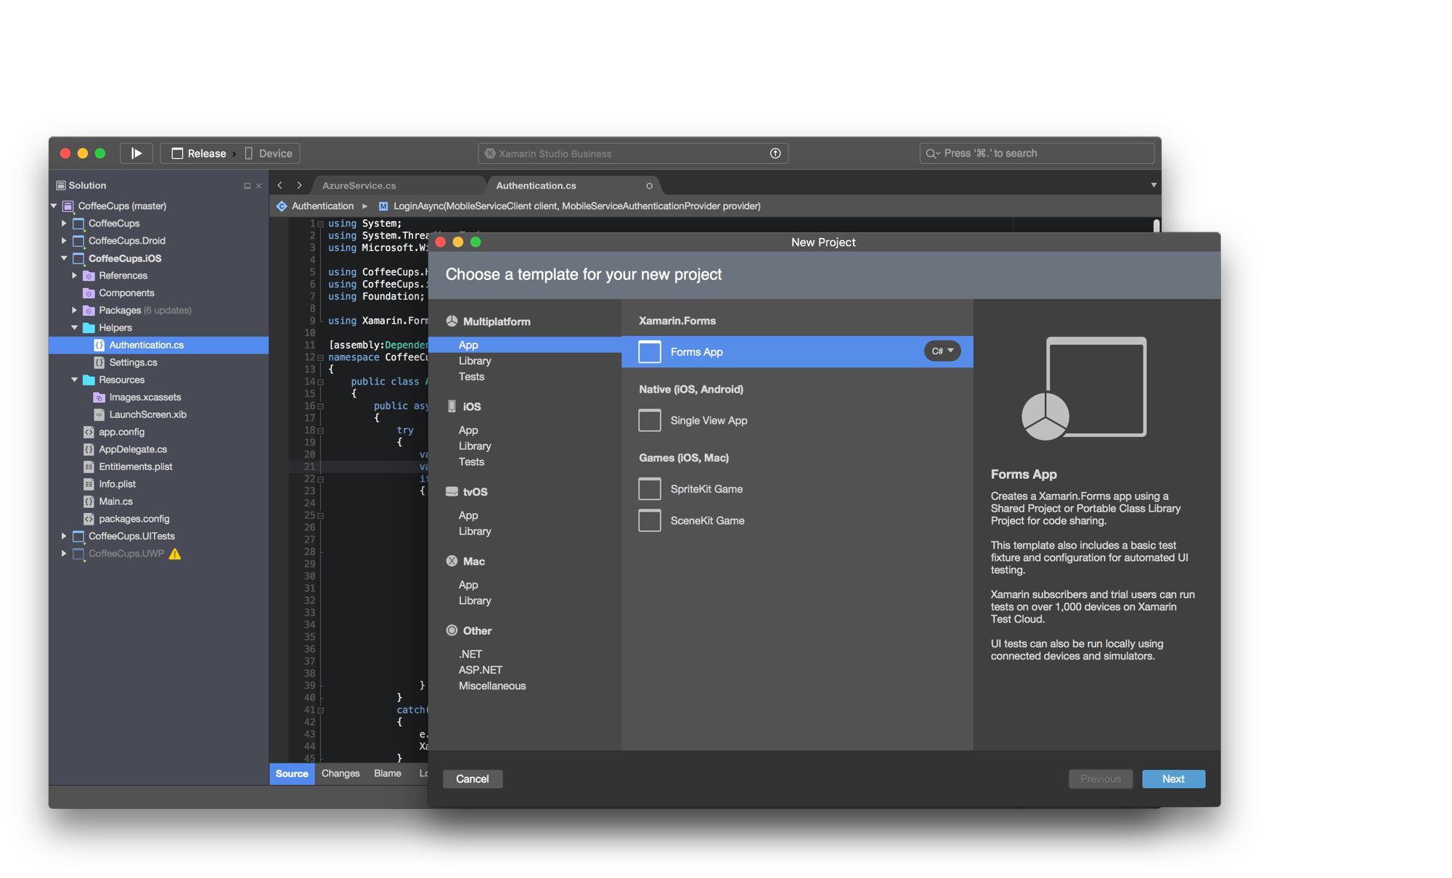
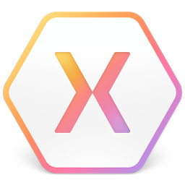
Xamarin Studio & Visual Studio – Mac
Notes:
Xamarin Studio on Mac offers: Android, iOS and Mac development
World Class IDE with great features:
Code Analysis
Upload to Test Flight
Git & Subversion Integration
Code Completion
Code Navigation
Easy transition from Visual Studio
The same Solution & Projects open in BOTH Xamarin Studio and Visual Studio!

Slide 34
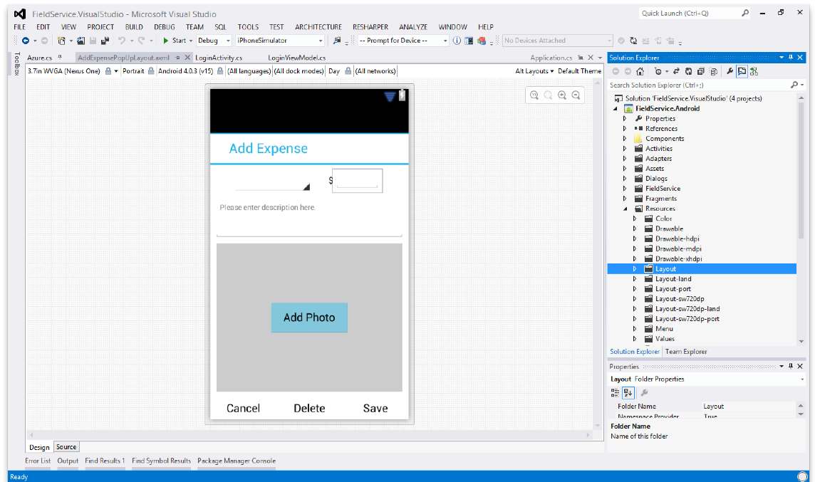
Diseñador de Android
Disponible en:
Xamarin Studio
Visual Studio
Crea la UI con drag & drop
Se puede probar con diferentes tamaños de pantallas, resoluciones y versiones de Android
Layouts guardados en archivos Android XML

Slide 35
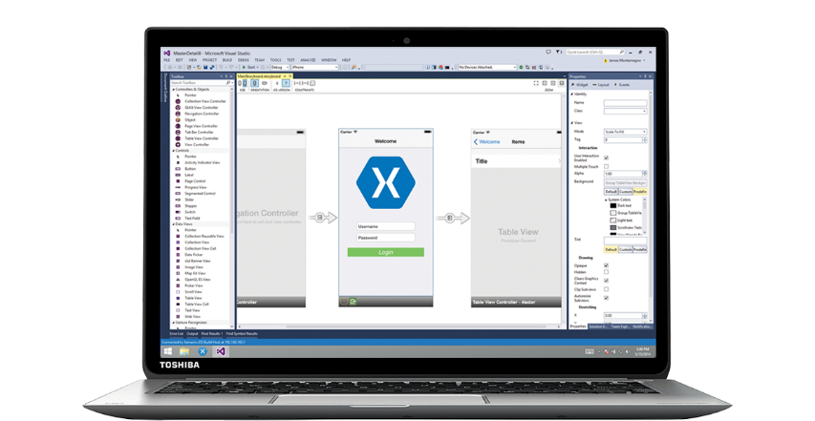
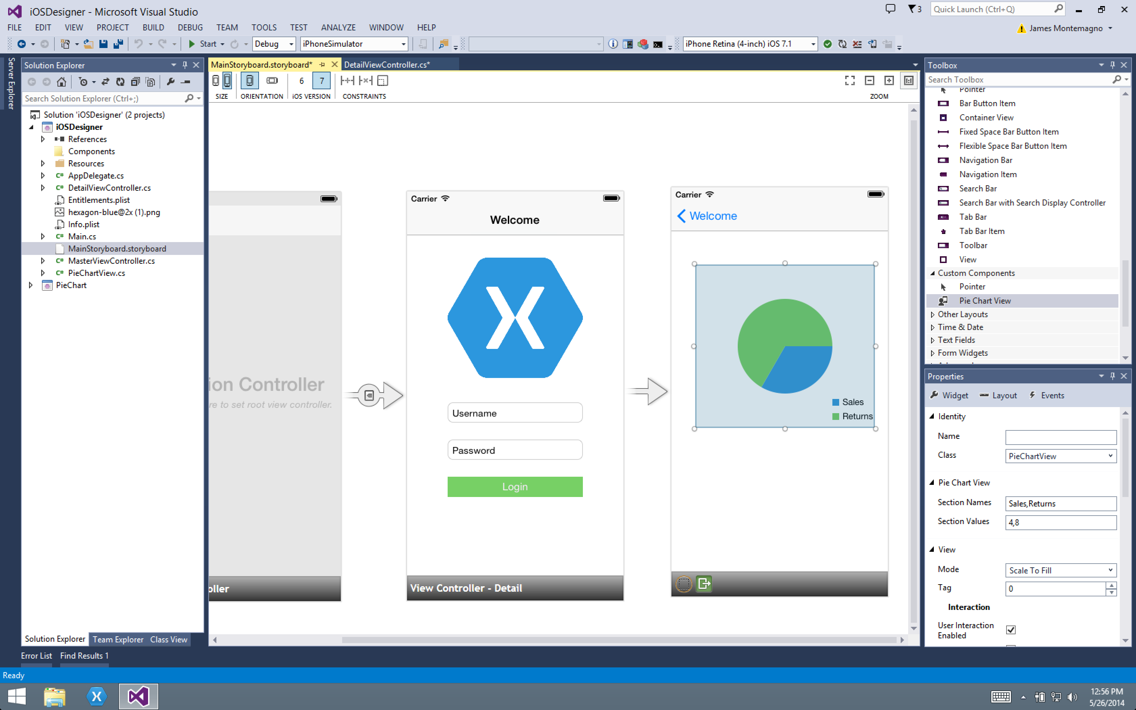
Diseñador de iOS
Disponible en Xamarin Studio y Visual Studio
Similar a otros diseñadores de Visual Studio
Soporta todos los elementos de UIKit
Editar components de terceros
Live preview

Slide 36
Vamos a echar un vistazo!

Slide 37
Xamarin.Forms
Crear interfaces nativas compartidas para iOS, Android, y Windows.
Notes:
Xamarin Forms is a new set of APIs allowing you to quickly and easily write shared User Interface code that is still rendered natively on each platform, while still providing direct access to the underlying SDKs if you need it.

Slide 38
Xamarin + Xamarin.Forms
iOS C# UI
Android C# UI
Windows C# UI
Shared UI Code
Shared C# Backend
Shared C# Backend
El enfoque tradicional
Con Xamarin.Forms: Más código compartido, nativo
Notes:
We see here the Xamarin approach we talked about earlier
This enables you to be highly productive, share code, but build out UI on each platform and access platform APIs
With Xamarin.Forms you now have a nice Shared UI Code layer, but still access to platform APIs
You can start from native, pick a few screens, or start with forms, and replace with native later

Slide 39
¿Qué incluye?
✓ 40+ páginas, layouts, y controles
(C# o XAML)
✓ Two-way data binding
✓ Navegación
✓ API de animaciones
✓ Dependency Service
✓ Messaging Center
Shared UI Code
Shared C# Backend
Notes:
Xamarin.Forms is much more that just a framework and includes everything you need to get up and running to build out full native applications.
If you are used to MVVM type of development you will feel right at home.

Slide 40

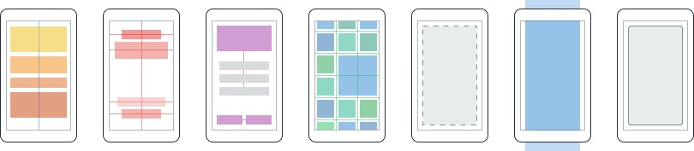
Layouts
Páginas
Content
MasterDetail
Navigation
Tabbed
Carousel
Stack
Absolute
Relative
Grid
ContentView
ScrollView
Frame
Notes:
First you have a set of pages for each screen of your application
There are things like Content, and MasterDetail which gives you a nice flyout
With a tabbed view you get the correct look on each platform
iOS on bottom, Android on top, and on WP you have a Pivot control
Inside of a page are layouts
A lot of options from something simple like a stack panel to complex and powerful grids

Slide 41
Controles
ActivityIndicator
BoxView
Button
DatePicker
Editor
Entry
Image
Label
ListView
Map
OpenGLView
Picker
ProgressBar
SearchBar
Slider
Stepper
TableView
TimePicker
WebView
EntryCell
ImageCell
SwitchCell
TextCell
ViewCell
Notes:
You have more than 40 controls, layouts, and pages to mix and match from.
These are all of the controls you have out of the box, you can of course create your own.
What is unique is you get the native control and have access to it.
Consider an Entry Field
On iOS it is mapped to UITextField
Android it is EditText
Windows Phone it is a TextBox

Slide 42
XAML Previewer

Slide 43
Hagamos una App!

Slide 44
Test
Notes:
Xamarin is your complete mobile solution.
Xamarin Platform is usually what you hear about which is building native iOS, Android, Mac, and Windows Apps all in C#
However Xamarin offers a wide range of products for developers to go mobile including Test Cloud, Hockey App, and a way to learn all of mobile with University.

Slide 45
Fragmentación de dispositivos
La complejidad de las Apps
Ciclos de releases rápidos
Expectación alta de los usuarios
Retos
Notes:
Well there are several challenges that we must overcome as mobile developers including….

Slide 46
En Mobile, la calidad cuesta
5
20
20
35
6
OS
Dispositivos
Lenguajes
Localizaciones
Tamaños de pantalla
9
19K+
39
57
27
15
OS
Dispositivos
Lenguajes
Localizaciones
Tamaños de pantalla
Fabricantes
8
Notes:
First let’s take a look at the shear number of configurations there are between iOS and Android. As iOS progresses this number is only set to increase, and on Android it is already a HUGE number of configurations to even think about testing.
iOS: 7, 7.1, 8, 8.1, 8.2

Slide 47
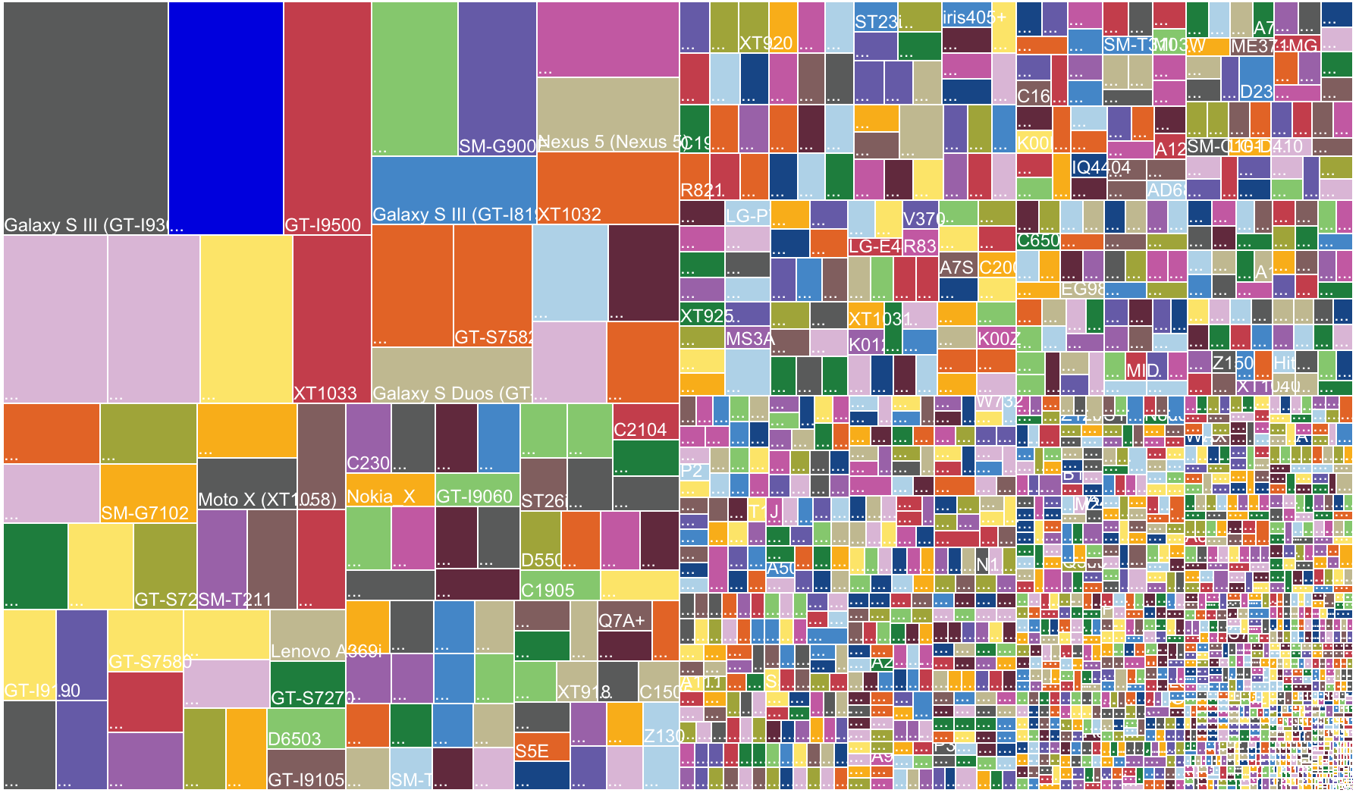
Notes:
OpenSignal is a global app that publishes an annual report on Android device fragmentation based on the distinct Android device types that download their app. This is their August 2015 data, with an astonishing 24,000 device types using their app, up by 60% from just last year.
Different device operating systems, form factors, screen sizes, resolutions, chip sets, and manufacturer modifications make it difficult to know that your app will work well on all devices

Slide 48
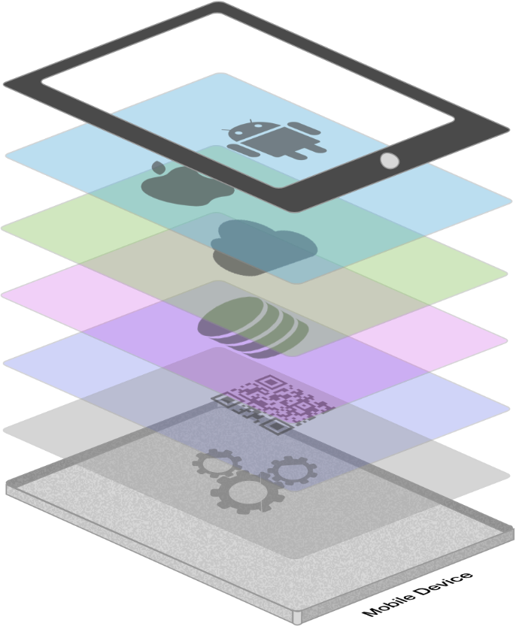







La complejidad de las Apps
Cientos de APIs iOS y Android
Public web APIs
Integración con Backend
Librerías Third party
Consumo de memoria, CPU y red
Notes:
The fragmentation isn’t just in the devices, but as we start to build on our applications you soon found out they are ever increasingly complex.

Slide 49
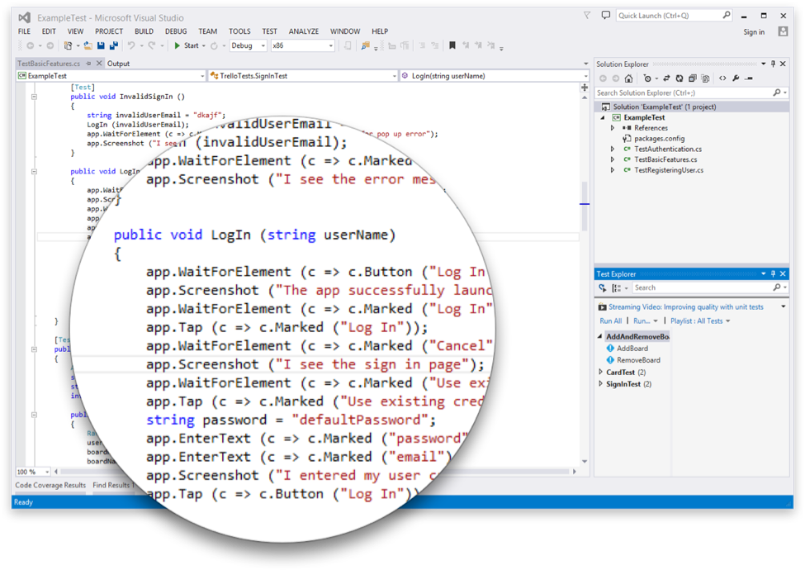
Introducción a Xamarin.UITest
Crea pruebas automatizadas de la interfaz de usuario con C#
Se pueden subir a Test Cloud o correr en un dispositvo o simulador
Funciona con Visual Studio o Xamarin Studio
Funciona con cualquier tipo de App: Nativa, Híbrida, o Xamarin
Notes:
This is where Xamarin.UITest comes in to help with this shift. Xamarin.UITest is a framework that ties in directly to the Nunit testing framework to write the UI tests. You can even run them directly against a simulator for free to do regression tests on your applications.
Freely available for testing on a Simulator*

Slide 50
Test Recorder for Visual Studio
Grabar UITests desde Visual Studio
Enviar directamente a Test Cloud
Se puede usar directamente la pantalla táctil de dispositivos Android

Slide 51

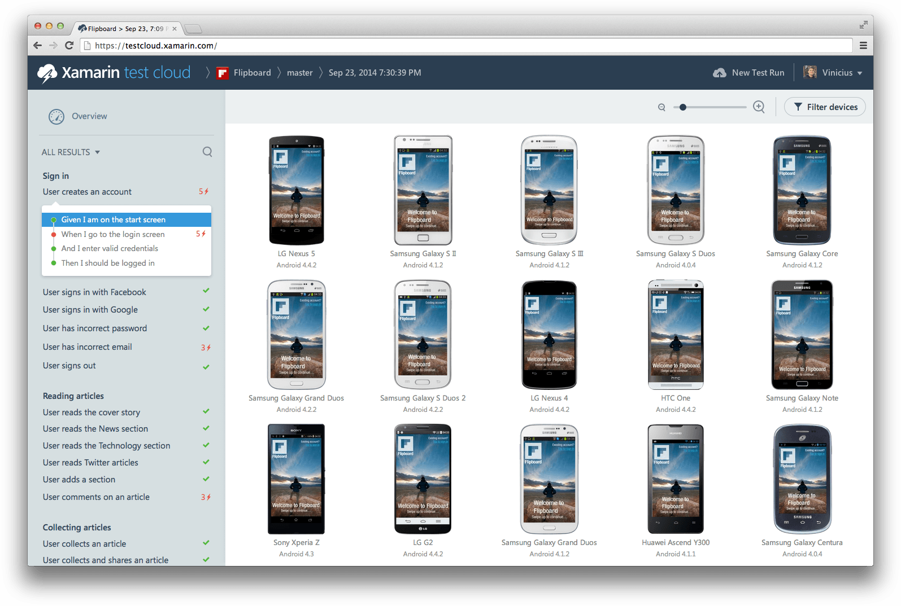
xamarin.com/testcloud
Notes:
Take test scripts and test again thousands of physical devices!
All Xamarin subscribers get free device time! Check store.xamarin.com for details.

Slide 52
Build
Notes:
Xamarin is your complete mobile solution.
Xamarin Platform is usually what you hear about which is building native iOS, Android, Mac, and Windows Apps all in C#
However Xamarin offers a wide range of products for developers to go mobile including Test Cloud, Hockey App, and a way to learn all of mobile with University.

Slide 53
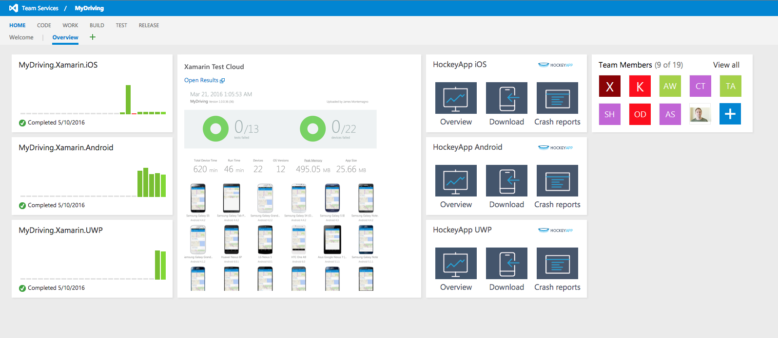
Visual Studio Team Services
Repositorio
Tareas
Build
Test
Release

Slide 54
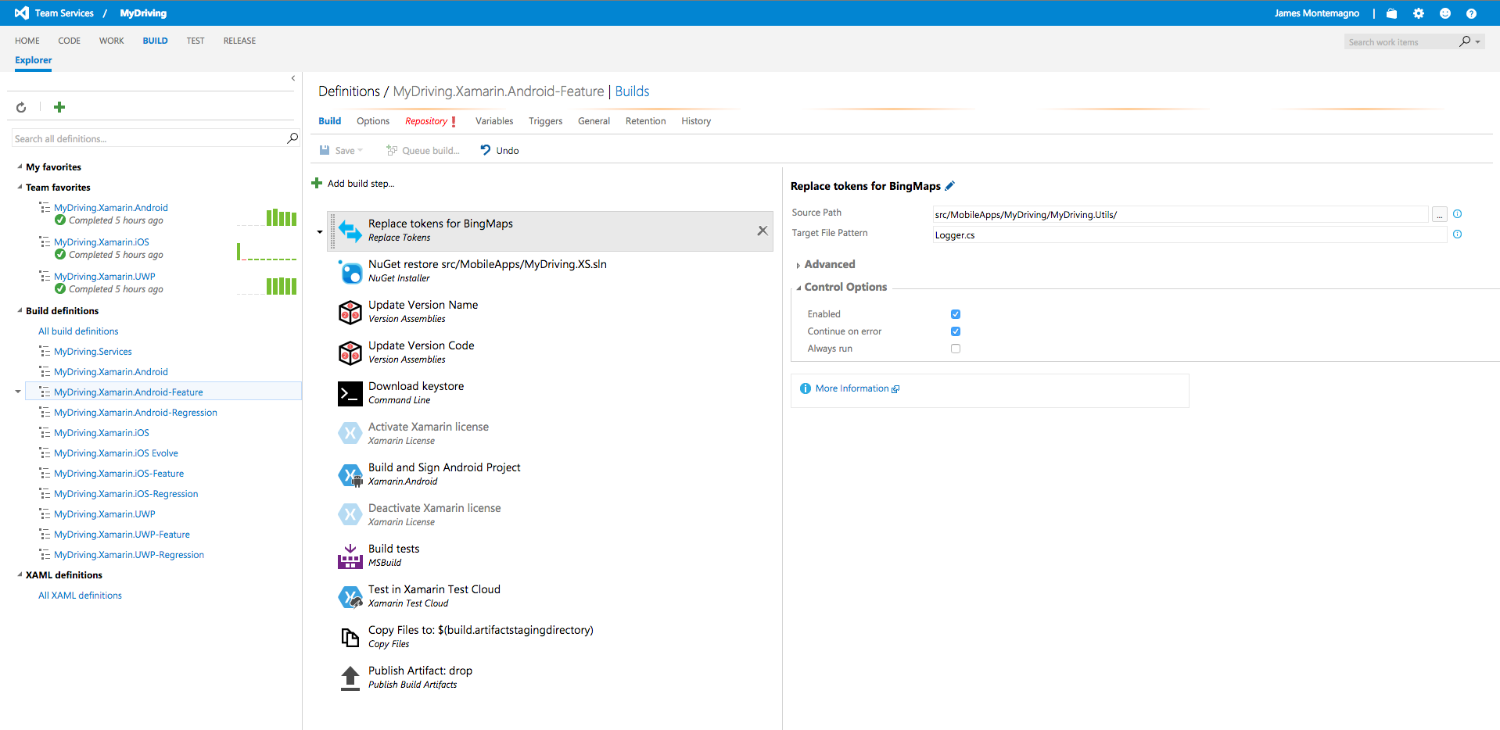
Visual Studio Team Services - Build

Slide 55
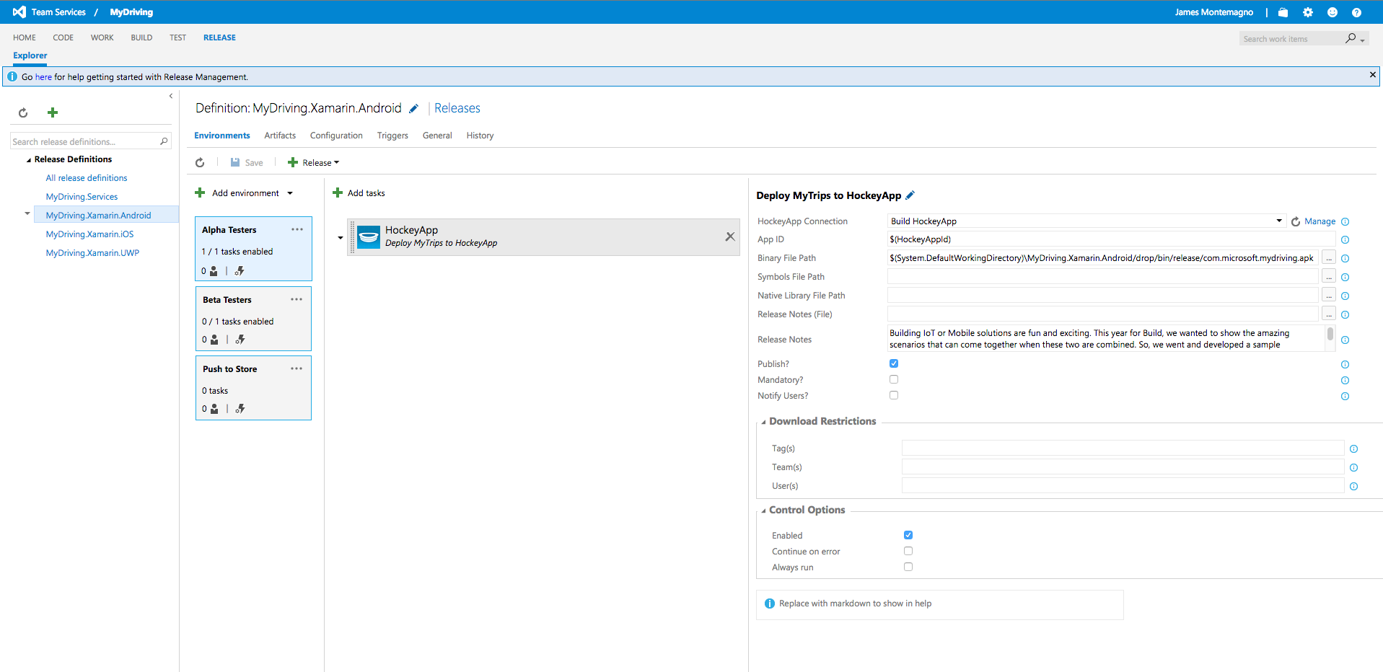
Visual Studio Team Services - Release

Slide 56
Distribuir & Monitorear
Notes:
Xamarin is your complete mobile solution.
Xamarin Platform is usually what you hear about which is building native iOS, Android, Mac, and Windows Apps all in C#
However Xamarin offers a wide range of products for developers to go mobile including Test Cloud, Hockey App, and a way to learn all of mobile with University.

Slide 57
HockeyApp
Mejora tus apps con monitorización Real-time.
Reportes de errores de código native y manejado
Notes:
Anything Else!
App Insights
Google Analytics
Flurry

Slide 58
HockeyApp

Slide 59
Xamarin – Solución móvil completa
Desarrollo
Test
Build
Distribuir
Monitorear
Notes:
Xamarin is your complete mobile solution.
Xamarin Platform is usually what you hear about which is building native iOS, Android, Mac, and Windows Apps all in C#
However Xamarin offers a wide range of products for developers to go mobile including Test Cloud, Hockey App, and a way to learn all of mobile with University.

Slide 60
Preguntas?
Javier Suárez Ruiz
@jsuarezruiz
javiersuarezruiz@Hotmail.com
javiersuarezruiz.wordpress.com
@jsuarezruiz

Slide 61


